Slide 1
CS 4504 Parallel and Distributed Computing Thread
Kun Suo
Computer Science, Kennesaw State University
https://kevinsuo.github.io/

Slide 2
Outline
What is thread?
Multiple thread application
Thread vs Process
Advantage and disadvantage of thread
Thread in Linux
Thread design
Kernel space vs User space
Local thread vs Global thread scheduling

Slide 3
Process review
Definition
An instance of a program running on a computer
An abstraction that supports running programs - -> cpu virtualization
An execution stream in the context of a particular process state - -> dynamic unit
A sequential stream of execution in its own address space - -> execution code line by line

Slide 4
What is a thread?
Thread
A finer-granularity entity for execution and parallelism
Lightweight process
A program in execution without dedicated address space
Multithreading
Running multiple threads within a single process

Slide 5
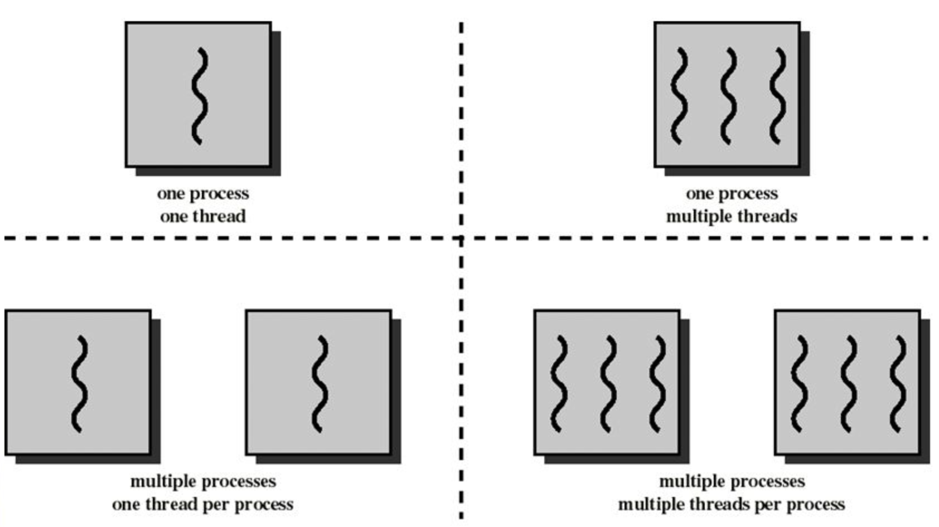
Finer-granularity entity
Process : thread = 1: N

Slide 6
What is a thread?
Thread
A finer-granularity entity for execution and parallelism
Lightweight process
A program in execution without dedicated address space
Multithreading
Running multiple threads within a single process

Slide 7
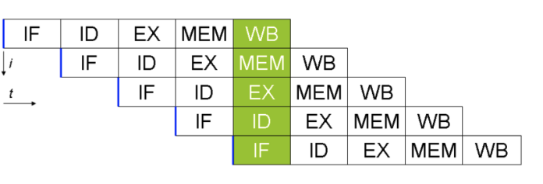
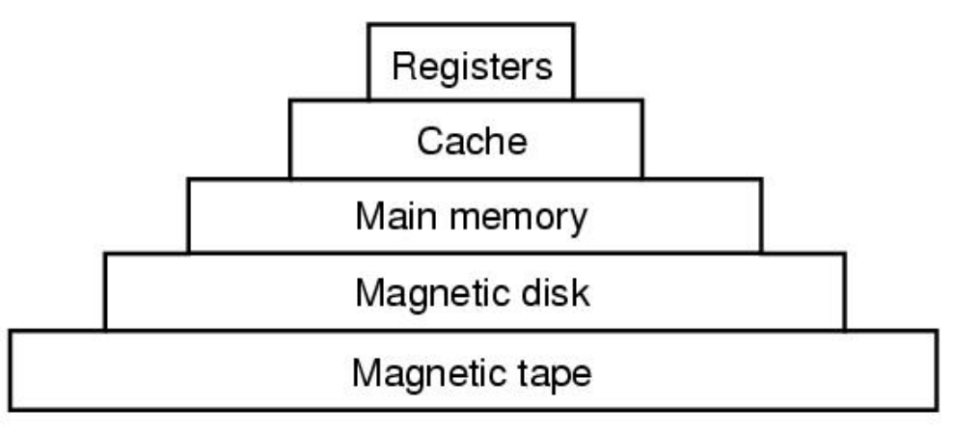
Process review
Two parts of a process
Sequential execution of instructions
Process state
registers: PC (program counter), SP (stack pointer),…
Memory: address space, code, data, stack, heap …
I/O status: open files …

Slide 8
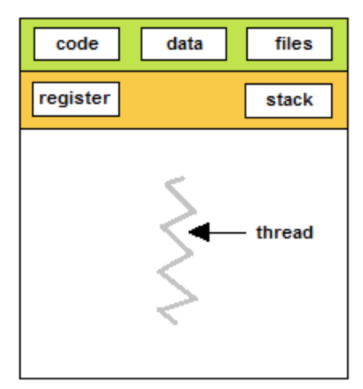
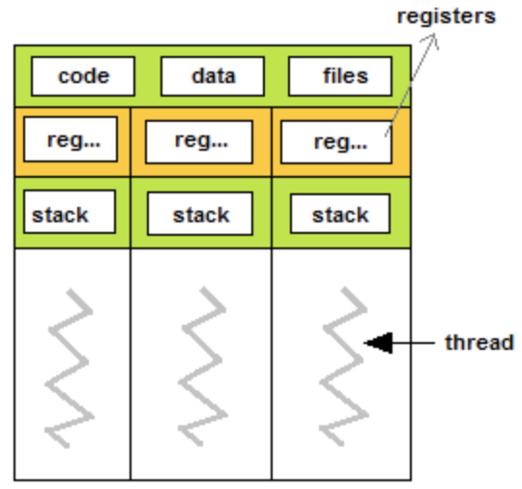
Lightweight process
Occupy more memory,
complex switching (e.g., save old data, switch to new data),
low CPU utilization (e.g., slow context switch)
Shared resources
Three processes
Three threads

Slide 9
What is a thread?
Thread
A finer-granularity entity for execution and parallelism
Lightweight process
A program in execution without dedicated address space
Multithreading
Running multiple threads within a single process

Slide 10
Dedicated address space
0x111111
0x222222
0x333333
0x666666
Three processes
Three threads

Slide 11
What is a thread?
Thread
A finer-granularity entity for execution and parallelism
Lightweight process
A program in execution without dedicated address space
Multithreading
Running multiple threads within a single process

Slide 12
What is a thread? Multithreading apps

Slide 13
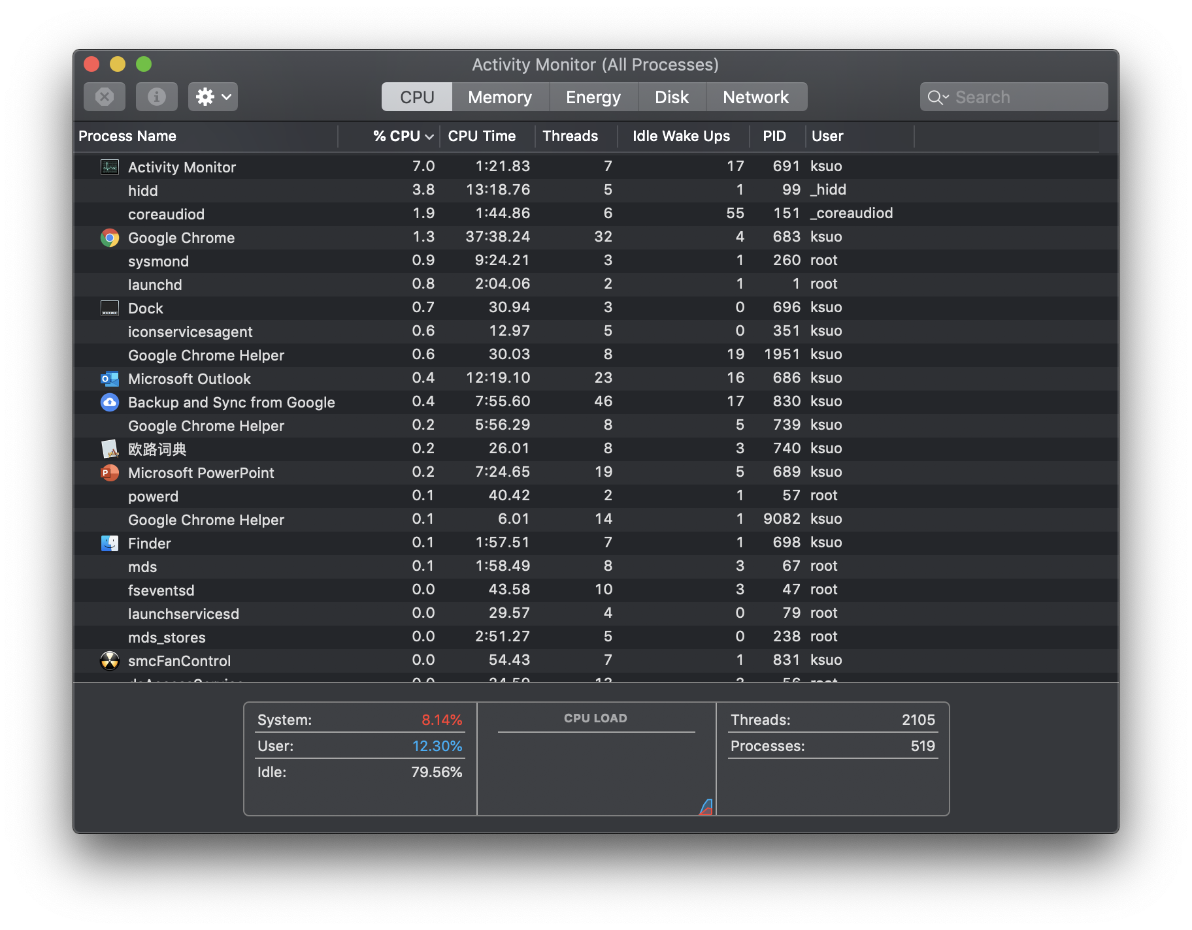
What is a thread? Multithreading apps

Slide 14
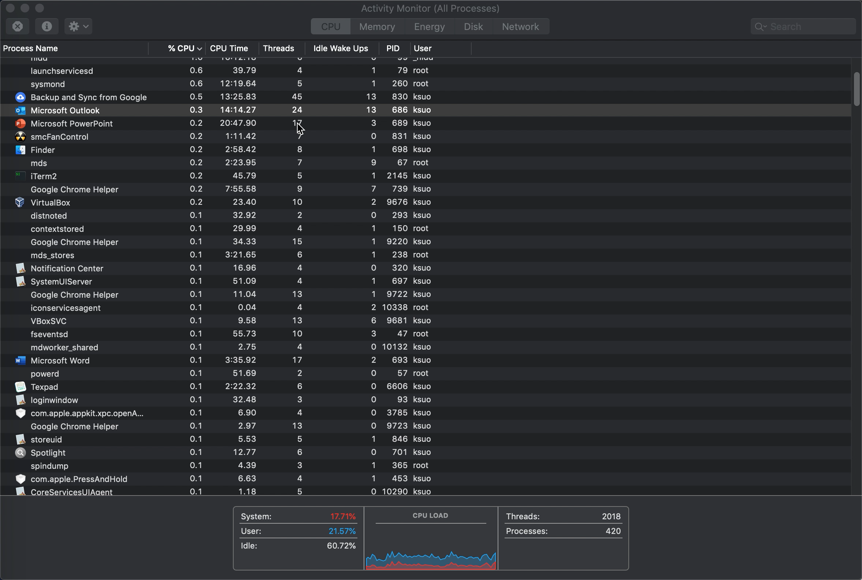
Multithreading apps
https://youtu.be/Me0mL44TxW0

Slide 15
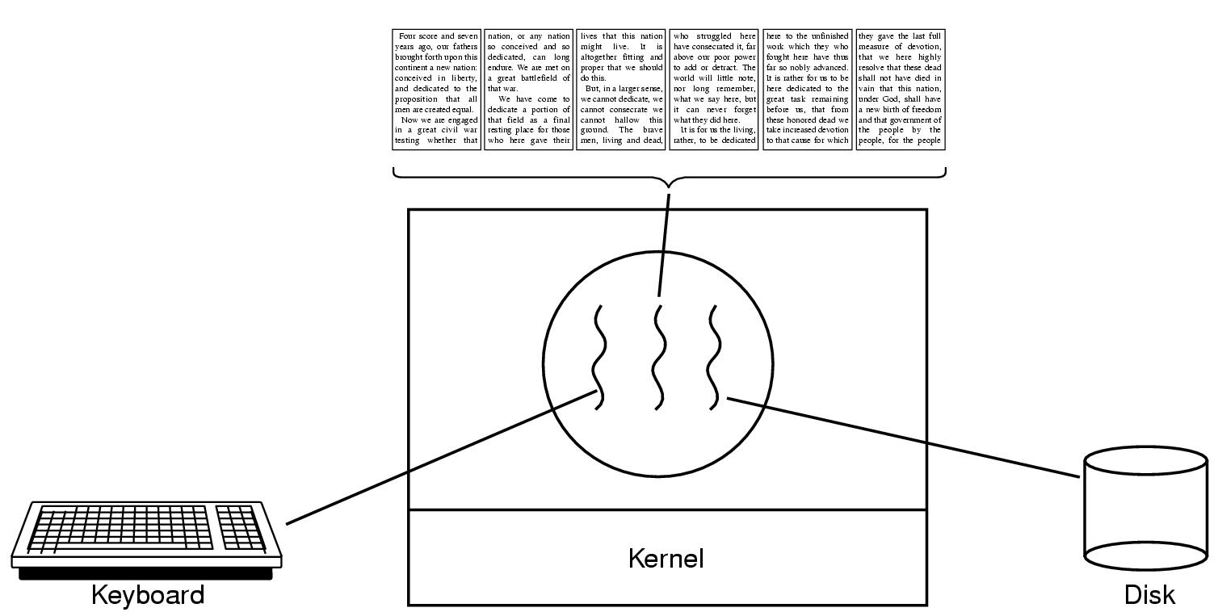
Example 1: A word process with three threads
Second thread handles screen display
Why not multiple processes ?
Third thread handles saving the document to disk
First thread handles keyboard input
A word process with three threads.

Slide 16
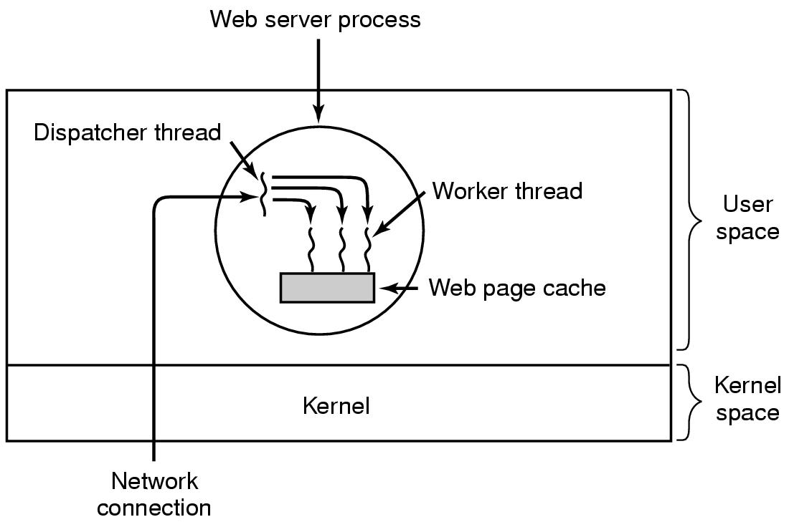
Example 2: a multi-threaded web server
Thread Type 1: A dispatcher thread waits for and accepts network connections
Thread Type 2: Each worker processes one network connection concurrently
A multithreaded Web server.

Slide 17
Example 2: a multi-threaded web server

Slide 18
Example 2: a multi-threaded web server
thread
thread
thread
thread

Slide 19
Why not multiple processes ?
Occupy more memory,
complex switching
low CPU utilization
Difficult to communicate
Expensive data sharing
Shared resources
Three processes
Three threads

Slide 20
Why multiple threads
Good example from Wikipedia: multiple threads within a single process are like multiple cooks trying to prepare the same meal together.
Each one is doing one thing.
They are probably doing different things.
They all share the same recipe but may be looking at different parts of it.
They have private state but can communicate easily.
They must coordinate!

Slide 21
Outline
What is thread?
Multiple thread application
Thread vs Process
Advantage and disadvantage of thread
Thread in Linux
Thread design
Kernel space vs User space
Local thread vs Global thread scheduling

Slide 22
Process vs. Thread comparison
 | Process | Thread
Concurrency and protection | ? | ?
Data structure | ? | ?
Performance | ? | ?

Slide 23
Processes vs. Threads (Concurrency and protection)
Three processes
Three threads

Slide 24
Processes vs. Threads (Concurrency and protection)
 | Process | Threads
Concurrency | Parallel execution stream of instructions | Maintain parallel execution stream of instructions
Protection

Slide 25
Processes vs. Threads (Concurrency and protection)
Shared resources
Three processes
Three threads

Slide 26
Processes vs. Threads (Concurrency and protection)
Separate concurrency from protection
 | Process | Threads
Concurrency | Parallel execution stream of instructions | Maintain parallel execution stream of instructions
Protection | A dedicated address space | Share address space with other threads

Slide 27
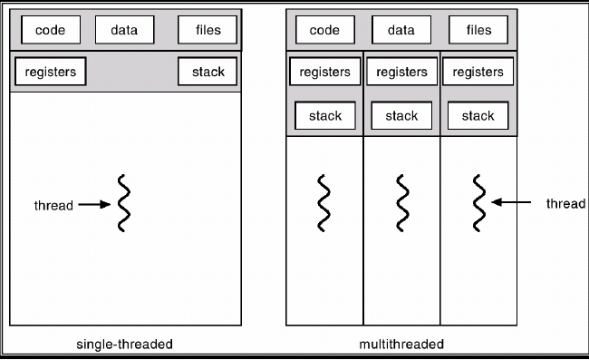

Processes vs. Threads (Data structure)
Process | Thread
Have data/code/heap | Share code, data, heap
Include at lease one thread | Multiple can coexist in a process
Have own address space, isolated from other processes | Only have own stack and registers

Slide 28
Processes vs. Threads (Data structure)
Context | Process | Thread
File pointer | *
Stack | * | *
Memory | *
State | * | *
Priority | * | *
I/O state | *
Authority | *

Slide 29
Processes vs. Threads (Data structure)
Context | Process | Thread
Scheduling | *
Statistics | *
File description | *
Read/Write pointer | *
Event/ Signal | *
Registers | * | *

Slide 30
Processes vs. Threads (Performance)
Process | Thread
Expensive to create | Inexpensive to create
Expensive context switching | Inexpensive context switching
IPC can be expensive | Efficient communication

Slide 31
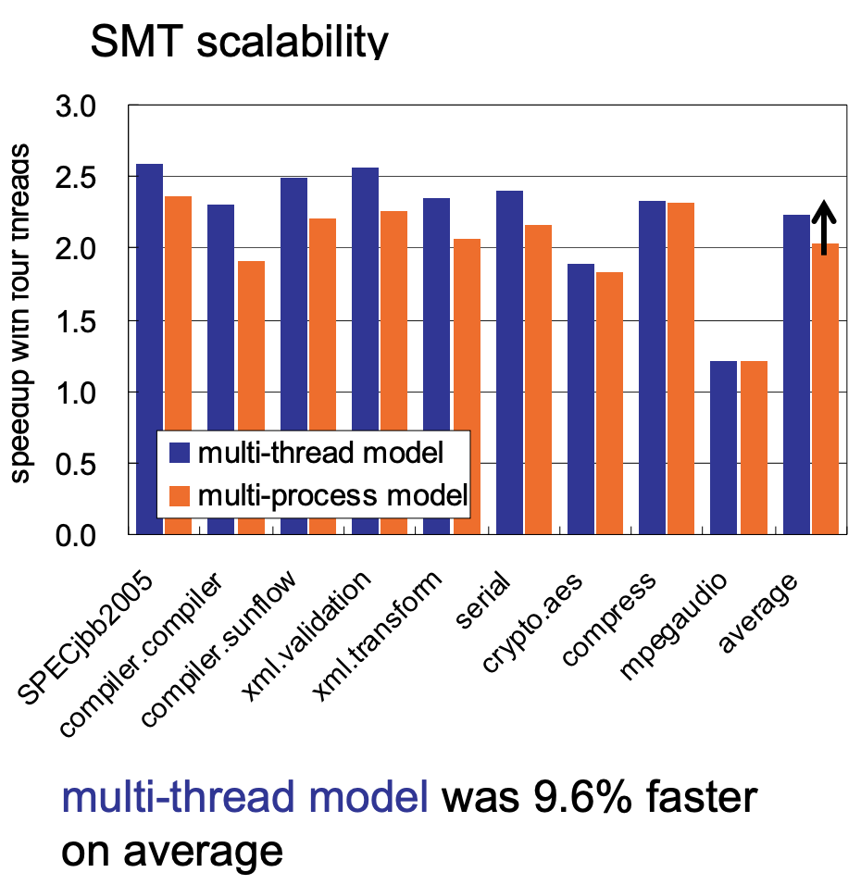

Paper: Performance of Multi-Process and Multi-Thread Processing on Multi-core SMT Processors
Our results showed that both models (multi-process vs. multi-thread) achieved almost comparable performance, whereas the multi-thread model achieved much better SMT scalability and higher performance.
https://pdfs.semanticscholar.org/dd54/a215131c5eacd997708c5c4612345fe989c7.pdf

Slide 32
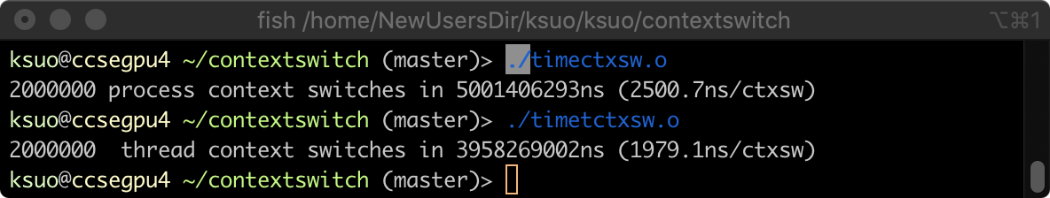
Demo
https://github.com/tsuna/contextswitch
timectxsw: Benchmarks the overhead of context switching between 2 processes.
timetctxsw: Benchmarks the overhead of context switching between 2 threads.
$ gcc xxx.c -o xxx.o -pthread
$ ./xxx.o

Slide 33
Outline
What is thread?
Multiple thread application
Thread vs Process
Advantage and disadvantage of thread
Thread in Linux
Thread design
Kernel space vs User space
Local thread vs Global thread scheduling

Slide 34
Advantages of Threads
Efficient creation
Only create the thread context
Express concurrency
Lightweight, better performance, higher scalability
Efficient communication
Communication can be carried out via shared data objects within the shared address space

Slide 35
Disadvantages of Threads
Shared data - -> Security
Global variables are shared between threads.
Accidental data changes can cause errors.
Lack of robustness
Crash in one thread will crash the entire process.
Some library functions may not be thread-safe
Library Functions that return pointers to static internal memory. E.g. gethostbyname()

Slide 36
Test
The following statements about threads, which ones are correct ( ).
A. The thread is introduced to improve the execution efficiency of the system and reduce the idle time of the processor and the scheduling switching time
B. Thread is the basic unit independently scheduled by the system
C. The thread itself basically does not own system resources, but it can share all the resources owned by the process with other threads belonging to the same process
D. Thread is also called lightweight process
E. Multiple threads in the same process can execute concurrently
ABCDE

Slide 37
Test
A process can contain multiple threads, each thread ( ).
A. Shares process virtual address space
B. The address space of each thread is completely independent
C. is the unit of resource allocation
D. Shares stack
A

Slide 38
Test
In the following description, ( ) is not a feature of multi-threaded systems.
A. Use threads to perform matrix multiplication operations in parallel
B. Web server uses thread to request http service
C. GUI-based debugger uses different threads to process user input, calculation, tracking and other operations
D. The keyboard driver creates a thread for each running process in response to the corresponding keyboard input
D

Slide 39
Test
The following description of the comparison between processes and threads ( ) is wrong:
A) The time overhead of concurrent execution of threads is less than that of processes
B) Inter-thread communication is simpler than process
C) Threads have fewer resources than processes
D) Thread is more stable than process
D

Slide 40
Outline
What is thread?
Multiple thread application
Thread vs Process
Advantage and disadvantage of thread
Thread in Linux
Thread design
Kernel space vs User space
Local thread vs Global thread scheduling

Slide 41
Processes vs. Threads in Linux
On Mon, 5 Aug 1996, Peter P. Eiserloh wrote: We need to keep a clear the concept of threads. Too many people seem to confuse a thread with a process. The following discussion does not reflect the current state of linux, but rather is an attempt to stay at a high level discussion.
http://lkml.iu.edu/hypermail/linux/kernel/9608/0191.html
The way Linux thinks about this (and the way I want things to work) is that there _is_ no such thing as a “process” or a “thread”. There is only the totality of the COE (called "task" by Linux).

Slide 42
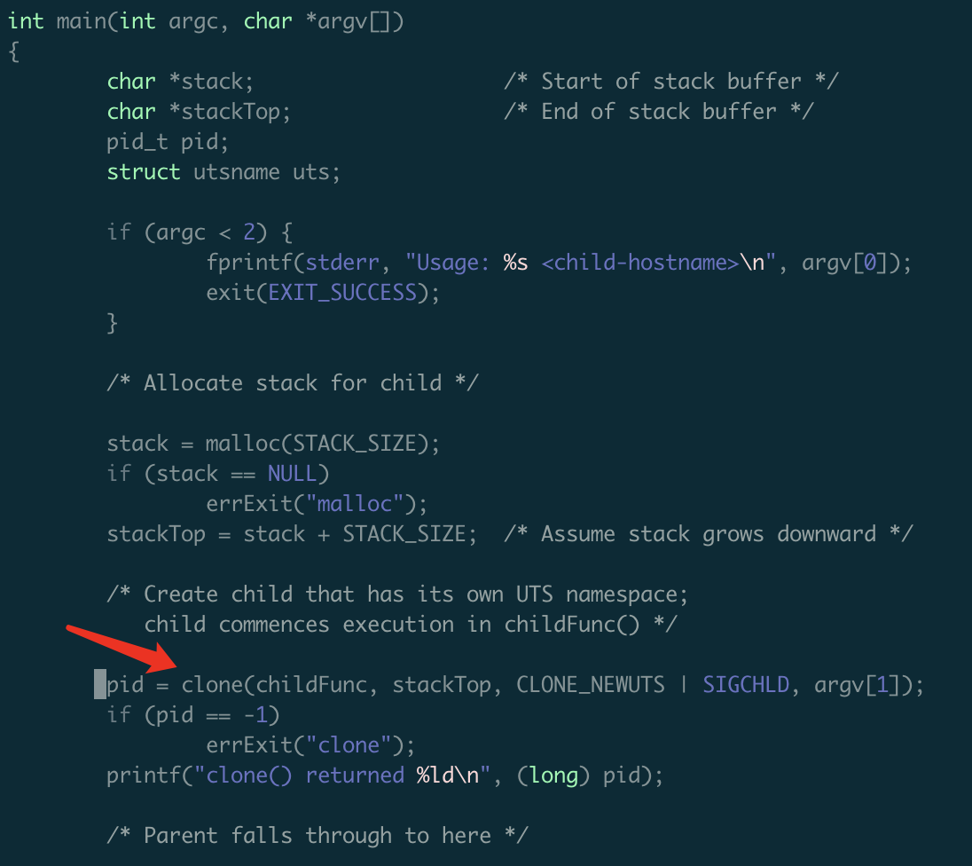
Thread creation: clone(), not fork()
Create new threads in Linux
Use clone()to create threads instead of using fork()
clone()is usually not called directly but from some threading libraries, such as pthread.
http://man7.org/linux/man-pages/man2/clone.2.html

Slide 43

Clone system call
No. 56, https://filippo.io/linux-syscall-table/

Slide 44
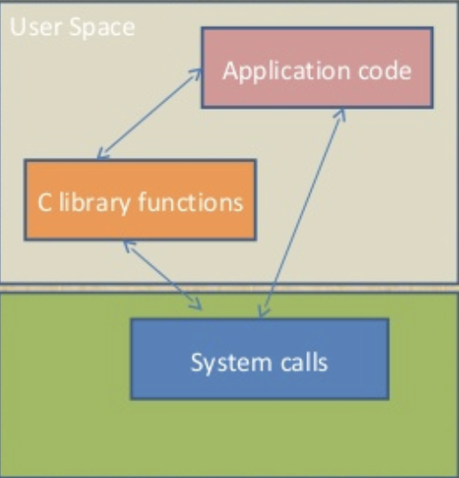
Clone system call
Pthread_create()
in the user space
Clone()
in the kernel
Operating Systems

Slide 45
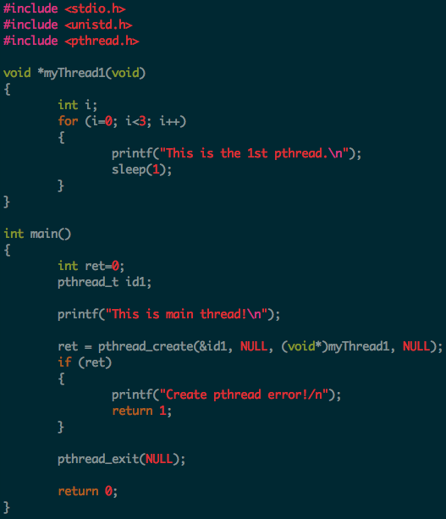
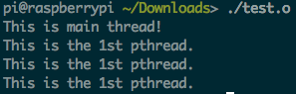
Pthread Creation Example
https://github.com/kevinsuo/CS7172/blob/master/pthread_create.c
Clone() in the kernel

Slide 46
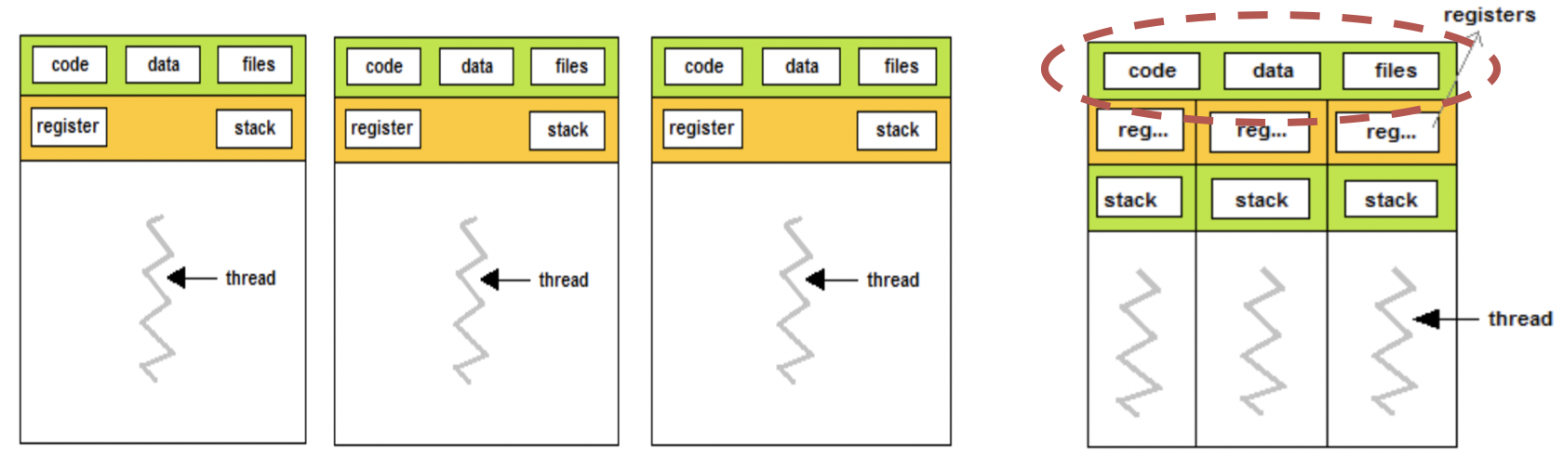
Fork vs clone
Fork:
All resources in PCB are copied from parent process to child process
Clone:
The resources in PCB are partly copied from one thread to another thread (the copied context is different in vfork)

Slide 47
Outline
What is thread?
Multiple thread application
Thread vs Process
Advantage and disadvantage of thread
Thread in Linux
Thread design
Kernel space vs User space
Local thread vs Global thread scheduling

Slide 48
Thread design
When you have multiple threads, where to put them?
Kernel space
User space

Slide 49





A comparison
Services in or out of campus
Government/Society
University

Slide 50
User-level Thread
When you have multiple threads, where to put them?
Kernel space
User space
Scheduling
management
Communication

Slide 51
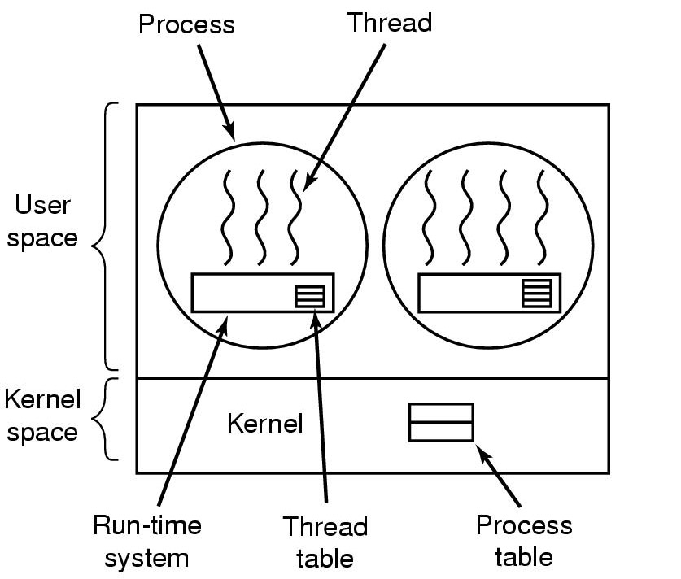
User-level Thread
User-level threads: the kernel knows nothing about them and managed by applications
A user-level threads package

Slide 52
Discussion
Advantages?
Government/Society
University

Slide 53
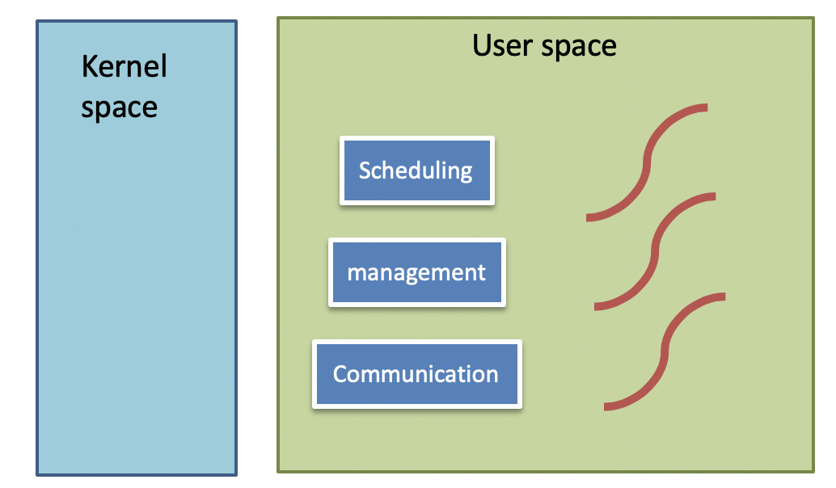
User-level Thread - Discussions
Advantages
No OS thread-support need
Lightweight: thread switching vs. process switching
Less memory
Faster context switch
Easier to communicate and data sharing
Management in the user space

Slide 54
Discussion
Disadvantages?
Government/Society
University

Slide 55
User-level Thread - Discussions
Disadvantages (less kernel support, need to implement all logic by application itself)
Scheduling:
How blocking system calls implemented? Called by a thread?
How to change blocking system calls to non-blocking?
Memory management:
How to deal with page faults?
Interrupt
How to stop a thread from running forever? No clock interrupts

Slide 56
Kernel-level Thread
When you have multiple threads, where to put them?
Kernel space
User space
Scheduling
management
Communication

Slide 57
Discussion
Advantages?
Government/Society
University

Slide 58
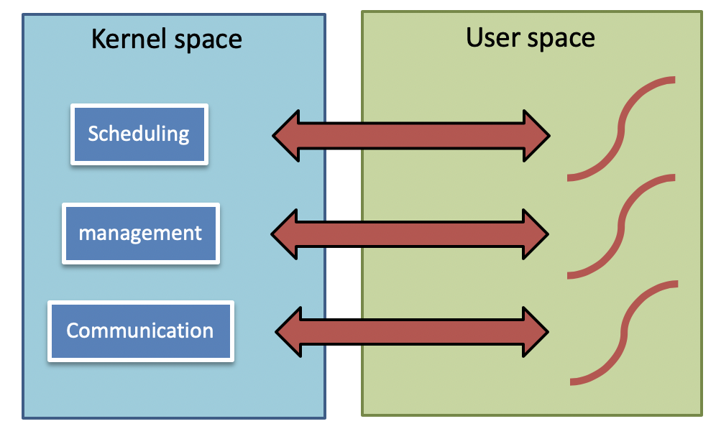
Implementing Threads in the Kernel
Kernel-level threads: managed by the kernel
Threads known to OS, use OS service directly
Scheduling, memory management, storage, I/O, etc.

Slide 59
Discussion
Disadvantages?
Government/Society
University

Slide 60
Implementing Threads in the Kernel
Kernel-level threads: managed by the kernel
Threads known to OS, use OS service directly
Scheduling, memory management, storage, I/O, etc.
Slow
Trap into the kernel mode
Expensive to create and switch
Create memory inside the kernel
Context switch between the kernel and user space

Slide 61
Threads in Hybrid-Space
When you have multiple threads, where to put them?
Kernel space
User space
Scheduling
management
Communication

Slide 62
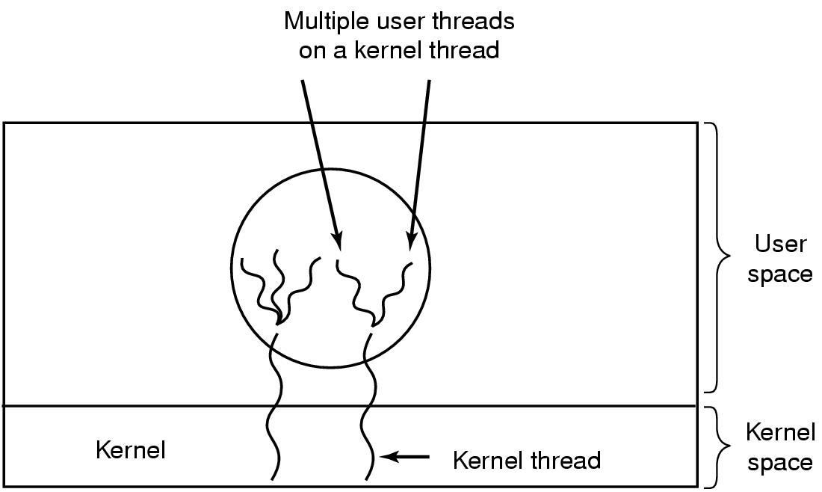
Hybrid Implementations
Use kernel-level threads and then multiplex user-level threads onto some or all of the kernel-level threads
Multiplexing user-level threads onto kernel-level threads
Enjoy the benefits of user and kernel level threads
Too complex !
Multiplexing user-level threads onto kernel- level threads

Slide 63
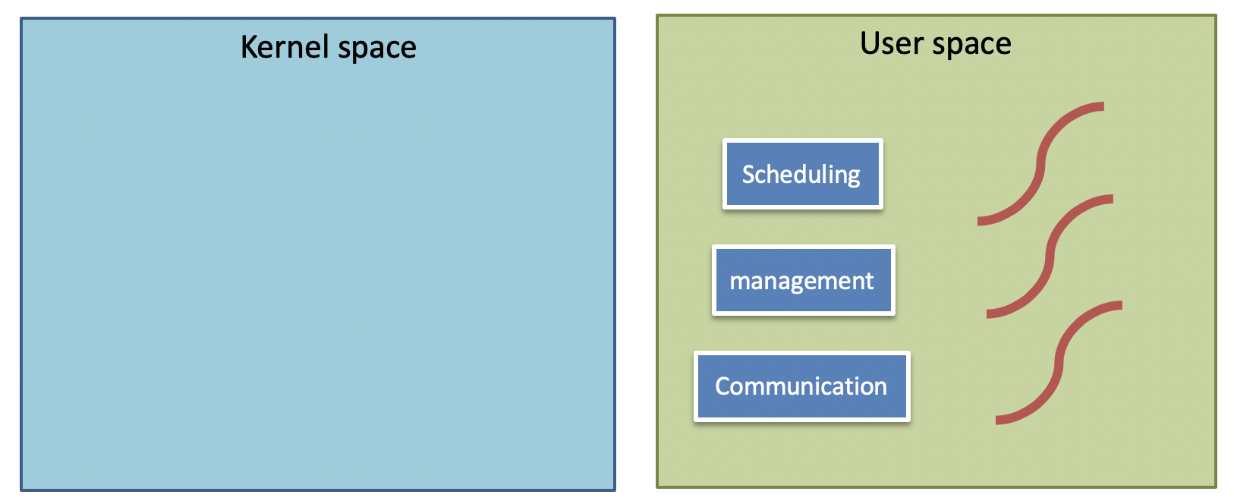
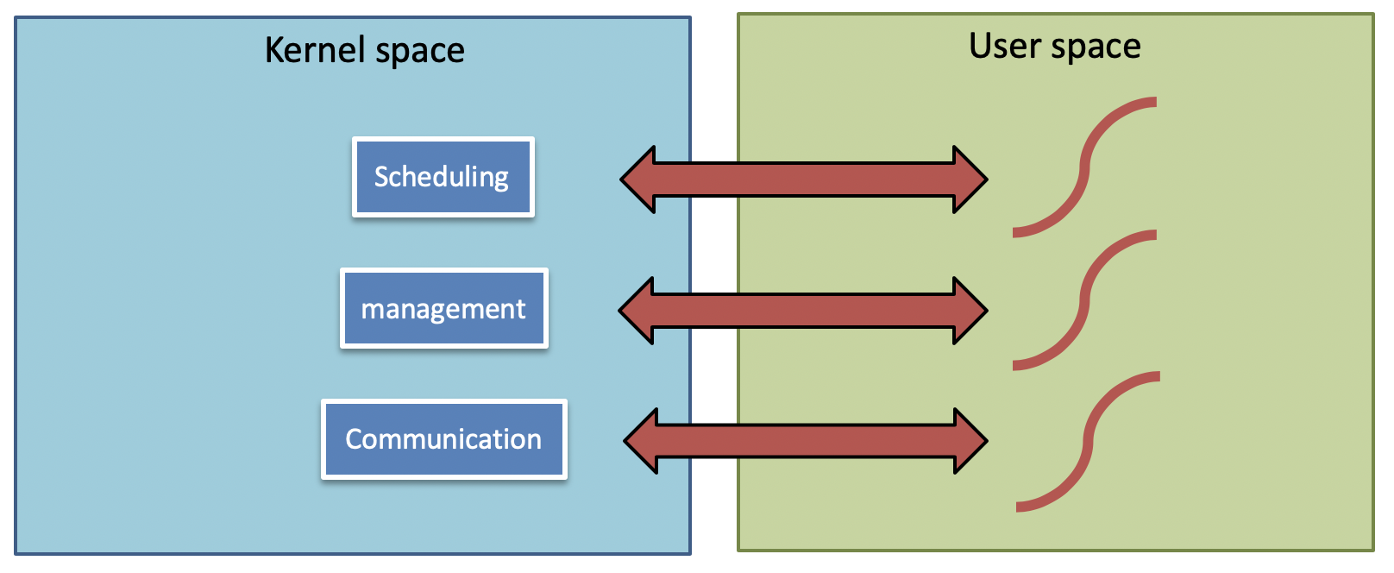
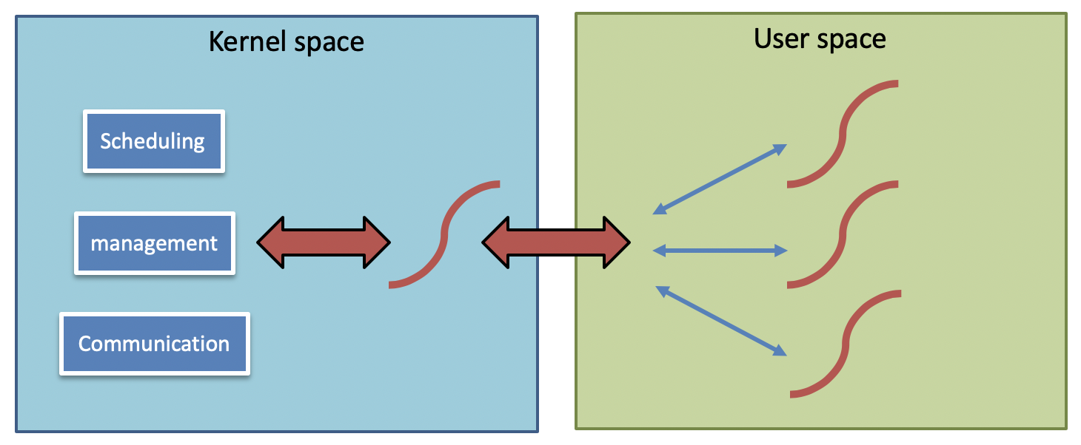
Thread in user level/kernel level/hybrid
user
kernel
hybrid

Slide 64
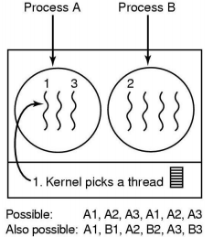
Thread design
When you have multiple threads, by what order should we execute them? - -> Scheduling

Slide 65
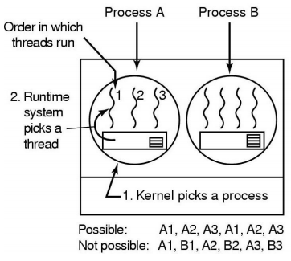
Local Thread Scheduling
Next thread is picked from among the threads belonging to the current process
Each process gets a timeslice from kernel.
Then the timeslice is divided up among the threads within the current process
Scheduling decision requires only local knowledge of threads within the current process. It can be implemented by using user or kernel level threads
For example, say process timeslice may be N ms, and each thread within the process runs for N/3 ms per cycle

Slide 66
Global Thread scheduling
Next thread to be scheduled is picked up from ANY process in the system.
Not just the current process
Timeslice is allocated at the granularity of threads
No notion of per-process timeslice
Global scheduling can be implemented only with kernel-level threads
Picking the next thread requires global knowledge of threads in all processes.
For example, say process timeslice may be N ms, For example each thread runs for 2N/7 ms per cycle

Slide 67

Local Thread Scheduling vs Global Thread scheduling
N/3
2N/7
N
N
N
N
1, next thread
2, time slice for each thread
3, implementation: user/kernel level vs. only kernel level thread

Slide 68
Multiple threads → Pandora's Concurrency Box
Multiple threads → Concurrency
The illusion of concurrency is both powerful and useful:
It helps us think about how to structure our applications - -> multiple threads apps
It hides latencies caused by hardware devices - -> accelerate execution
Unfortunately, concurrency also creates problems:
Coordination: how do we enable efficient communication between the multiple threads involved in performing a single task?
Correctness: how do we ensure that shared information remains consistent when being accessed by multiple threads concurrently?

Slide 69
Concurrency and multi-threads
Unless precisely synchronized, threads may:
Be run in any order,
Be stopped and restarted at any time,
Remain stopped for arbitrary lengths of time.
Generally these are good things - - the operating system is responsible for how to allocate resources.
Problems
Talk about CPU scheduling, memory management, lock, synchronization in future talks

Slide 70
Conclusion
What is thread?
Multiple thread application
Thread vs Process
Advantage and disadvantage of thread
Thread in Linux
Thread design
Kernel space vs User space
Local thread vs Global thread scheduling

